Slide 1
Building a settings management practice
Kim Oppalfens
Consultant @ OSCC
Twitter @TheWmiGuy
April Fool MVP

Slide 2
Building a settings management practice
Challenges, goals and some advice

Slide 3
Setting expectations
100% non-technical
0 Demo’s
Thought provoking to avoid re-making the mistakes of the past
It’s only partially about the tools
The principal rule of settings management by
- Kim Oppalfens : “Decent settings management requires an effort.”

Slide 4



No Ownership of settings
Applicability
No/Limited Reporting
Lack of/no documentation
No strategy/philosophy on settings
Challenges
No cleanup
Adhoc Settings Management
Object sprawl
Setting Galore

Slide 5
How did we get here?
“Gradually, then suddenly”
-Ernest Hemmingway
Notes:
People pleasing instead of saying no
Hard to say no because no rules where ever defined on how to do settings management
Lack of documentation killed the possibility to do cleanup

Slide 6
Building the practice
The principal rule of settings management by - Kim Oppalfens : “Decent settings management requires an effort.”
Getting started
Set goals & (Technical) requirements
Define setting classifications
Define target families
Decide what to document
Notes:
Deciding what to document will be impacted by the goals you set and the tools you use

Slide 7
Goals & Requirements – an example*
Has the flexibility to allow for operational lifecycle management of settings management objects
Has Easy UI that covers the settings the organization needs
Has Centralized reporting
Has centralized repository with rollback capabilities
Offers ability to link setting on a device to the centralized settings management object
Applicable from anywhere
Has the ability to offer setting suggestions (aka. Preferences)
Has the ability to completely remove all settings on a device
Notes:
This is by no means a prescriptive example everyone should follow, nor is the list softed in any specific way

Slide 8
Define settings classification – an Example
UI (User Interface) related items
UX (User eXperience) related items
Security related items
Compliance related items

Slide 9
Define target classes of devices
Targeting is often done adhoc per setting
This leads to messy implementations
Try to build homogenous groups of devices
Think long and hard before you define a new class of devices for non-security or non-compliance related reasons *
Notes:
* If you’ve thought long and hard and still feel this particular setting warrants a new class of devices you might want to do some additional thinking and soul searching.

Slide 10
Decide what to document – an example
Settings owner
Setting expiry date (Re-visit settings needs on a recurring basis)
Target class(es)
Setting classification
Motivation for enforcing the setting
Enforced / suggested (aka preferences)
Client side artifacts (reg keys etc)
Link to / description that explains impact
For Enforced settings, default behaviour when settings isn’t overwritten

Slide 11
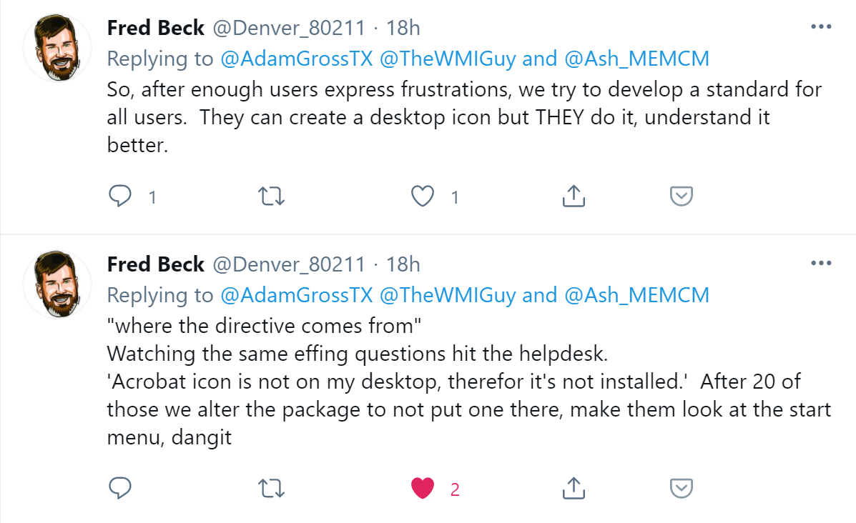
How do I decide what settings to set?
For security & Compliance start from the different Microsoft published baselines
For UI & UX have steered focus boards
“Understand your role, own your bias.”
- Kim Oppalfens
“If I had asked people what they wanted, they would have said faster horses.”
- Henry Ford (presumably)

Slide 12
Thank you!
MSEndPointMgr.com#MSEndPointMgr
System Center User Group
Finland
#SCUGFI
System Center User Group Denmark
#SCUGDK
System Center User Group Sweden
#SCUGSE
Modern Management User Group Norway
#MMUGNO

